Slide 1
Spring workshop
Karthikeyan Bollu Ganesh
Michael Inden
Asmiq Academy

Slide 2
Contents
Introduction
Spring Framework I
What‘s new in Spring 5.x ?
Dependency Injection
DI/IoC in Spring
XML Configuration
Java Configuration
Stereotype annotations @Component, @Configuration, @Service, @Autowired etc.
Bean Lifecycle
Bean Scopes
Exercises
Spring Framework II
Web-MVC
Exercises
Spring Boot I
Introduction
Spring Initializr
REST Service with Spring-Boot
Spring Dev-tools Demo
Testing
Exercises

Slide 3

Introduction - Spring
Rod Johnson – Father of Spring
To overcome the complexities of the EJB 2.x
Spring was born on 2002

Slide 4
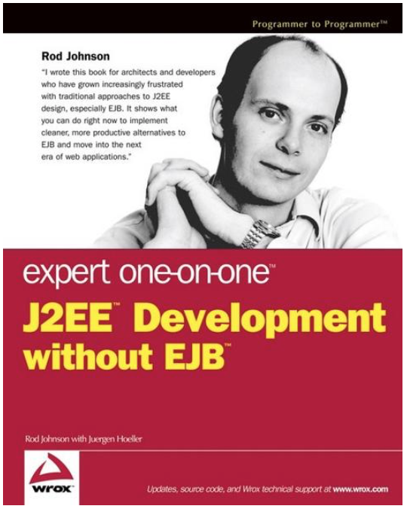
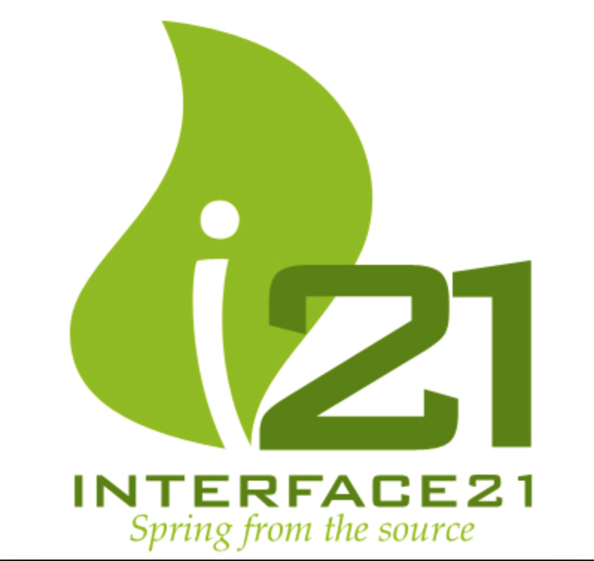


Spring birth
V 0.9
Oct. 2002
Notes:
Rod Johnson wrote this book on 2002 with describes the complexities of the EJB and he wrote all the infrastructure code for the dependency injection in the package com.interface21. Later Jürgen Höller requested him to create a open source framework based on this infrastructure code, which gave birth to the Spring framework.

Slide 5




Spring framework versions history
2003
2006
2009
2013
2017
1.0
2.0
3.0
4.0
5.0

Slide 6
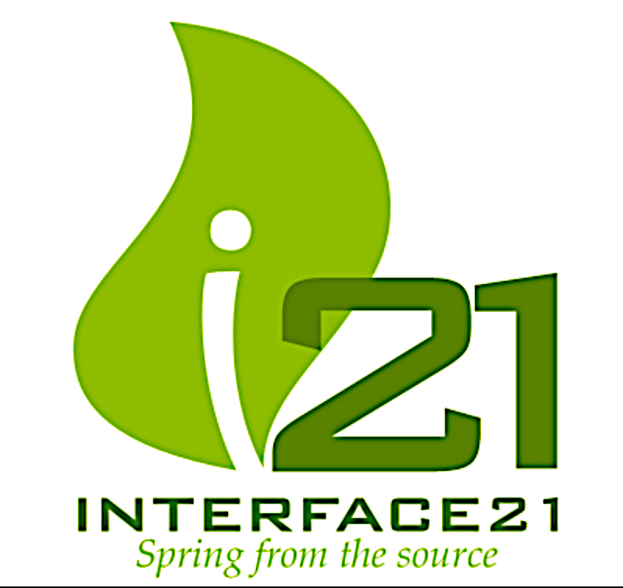



Spring company history
2008
2009
2002
2013
Notes:
In April 2013 VMware, and its parent company EMC Corporation, formally created a joint venture (with GE) called Pivotal Software.

Slide 7
Spring - Benefits
Light weight
Just POJO – need not implement/extend any framework interfaces/classes
Modular
Include just the needed module to use the needed functionality.
For DI just include spring-context
Non-intrusive
domain logic code generally has no dependencies on the framework itself
Notes:
Light weight/ Non-intrusive: POJO means Plain Old Java Object. It refers to a Java object (instance of definition) that isn't bogged down by framework extensions. -> https://spring.io/understanding/POJO
Modular: We do not all of the spring‘s modules to create an app. Forexample to use the DI functionality in our web-app, we can just add the spring-context module.

Slide 8
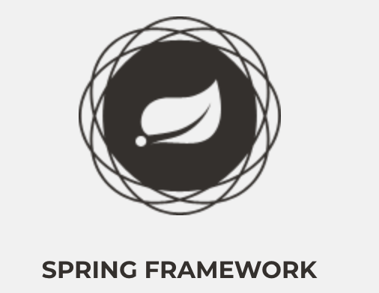
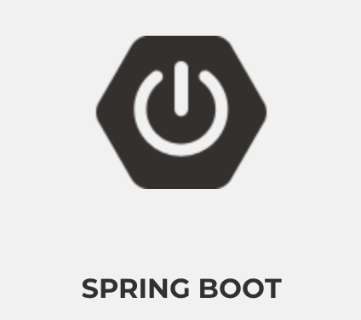

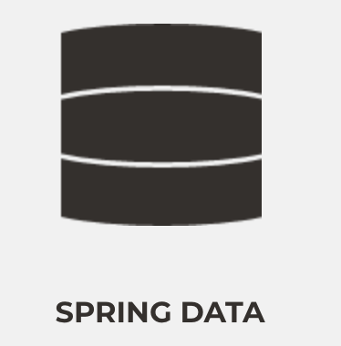

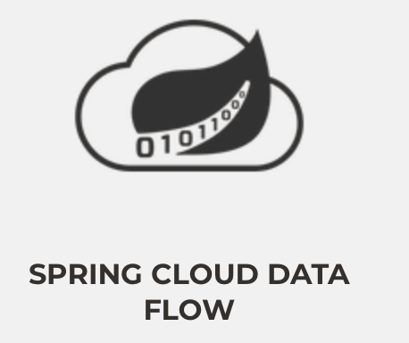
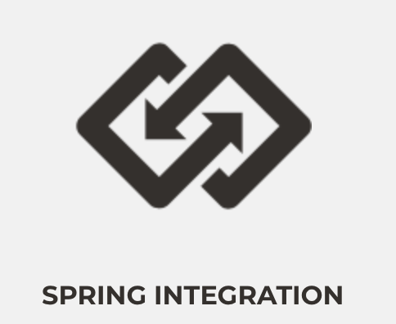

Major Spring Projects

Slide 9


Spring Framework JDK Baseline
Version | JDK 6 | JDK 7 | JDK 8 | JDK 9 | JDK 10 | JDK 11 | JDK 12
4.3.x
5.0.x
5.1.x

Slide 10
Spring Framework 5 + JDK 9 Module
Does Spring Framework 5 work with the new Java 9 module system?
Yes, Spring Framework 5 ships with automatic module name entries in the manifests of our Spring Framework 5 jars. The public API surface of the Spring libraries remains unchanged.

